Slide 1


Fundamentals of computer vision
Artemiy Firsov

Slide 2
General information
36 academical hours of lectures and seminars
72 academical hours of homework (faster – better for you☺)
Attendance + home tasks affect the final grade
Materials - https://github.com/ArtemiyFirsov/nsu-computer-vision
Intro test https://forms.gle/CqLzoudhmB6yx8hR8 - must be done
Questions – Telegram
My Pocket account – many useful links
Some useful links

Slide 3

What is cv?
Visual perception is the ability to interpret the surrounding environment using light in the visible spectrum reflected by the objects in the environment.
Computer vision is an interdisciplinary field that deals with how computers can be made for gaining high-level understanding from digital images or videos. From the perspective of engineering, it seeks to automate tasks that the human visual system can do

Slide 4


problems
Digits recognition

Slide 5
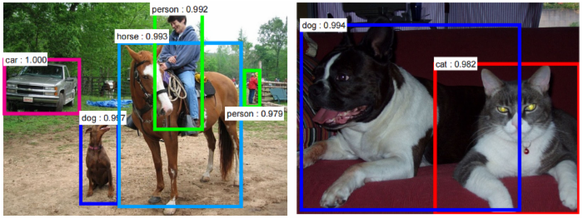
problems
Digits recognition
Object detection

Slide 6
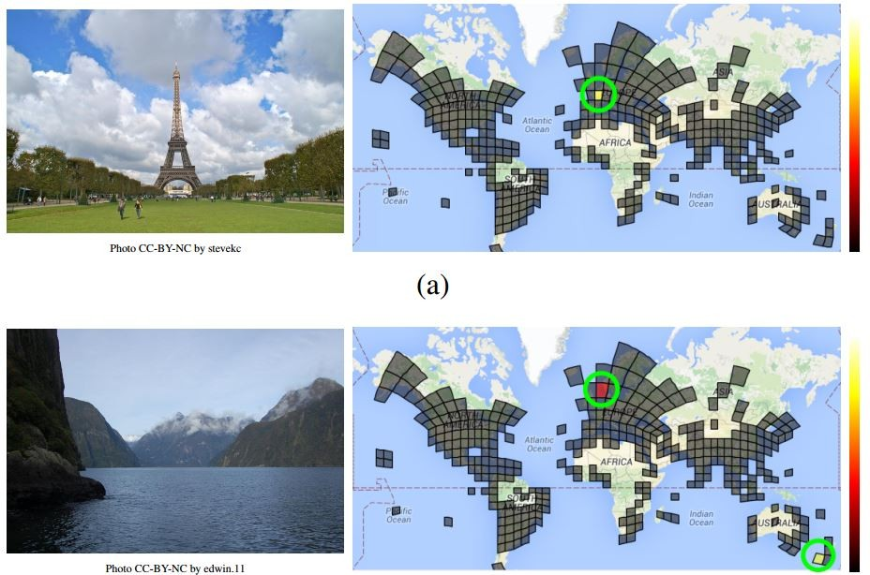
problems
Digits recognition
Object detection
Places recognition

Slide 7
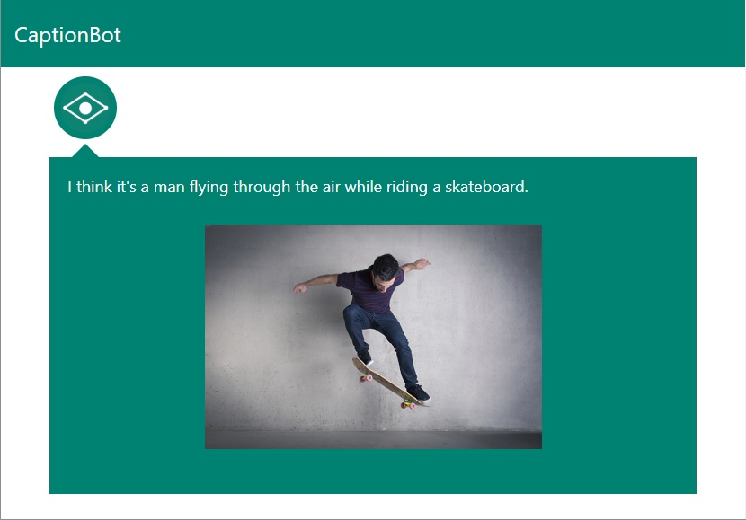
problems
Digits recognition
Object detection
Places recognition
Properties recognition

Slide 8
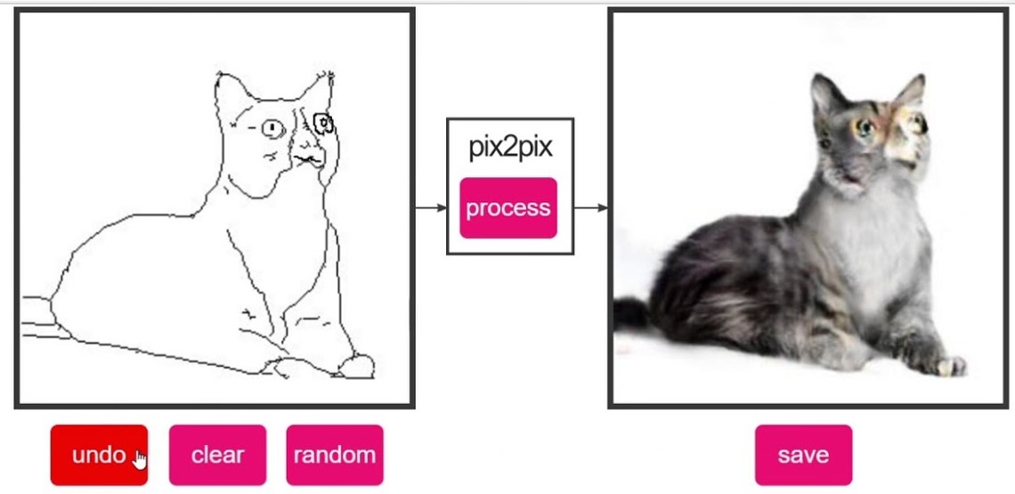
problems
Digits recognition
Object detection
Places recognition
Properties recognition
Creating new images

Slide 9
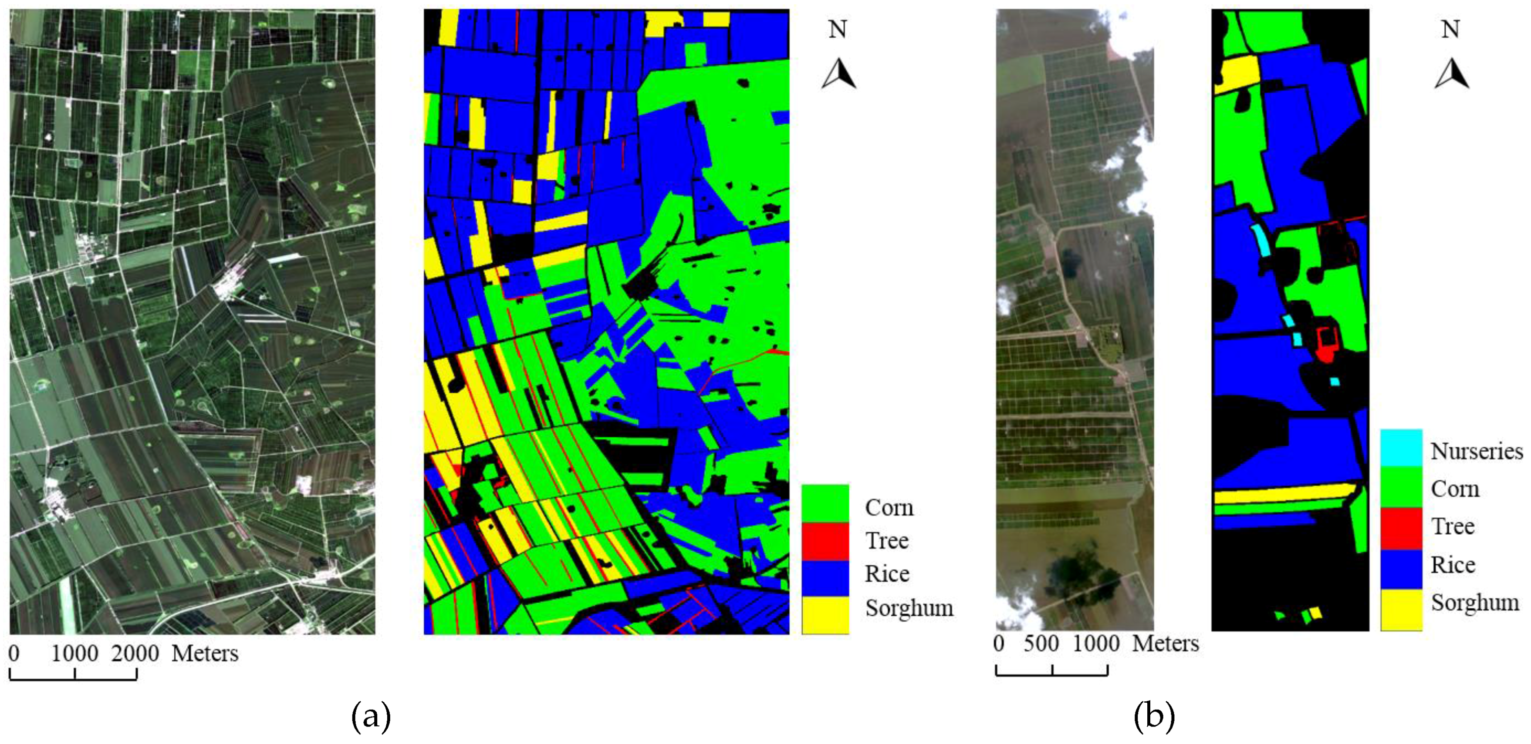
problems
Digits recognition
Object detection
Places recognition
Properties recognition
Creating new images
Shape and distances detection

Slide 10
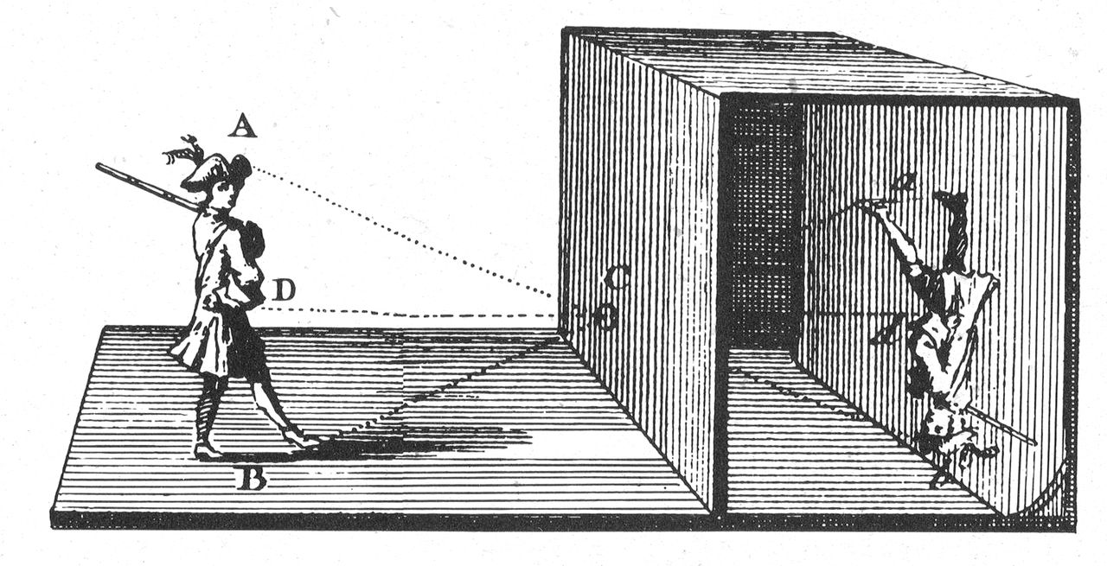
Pinhole camera (camera obscura), 5-6 BC

Slide 11
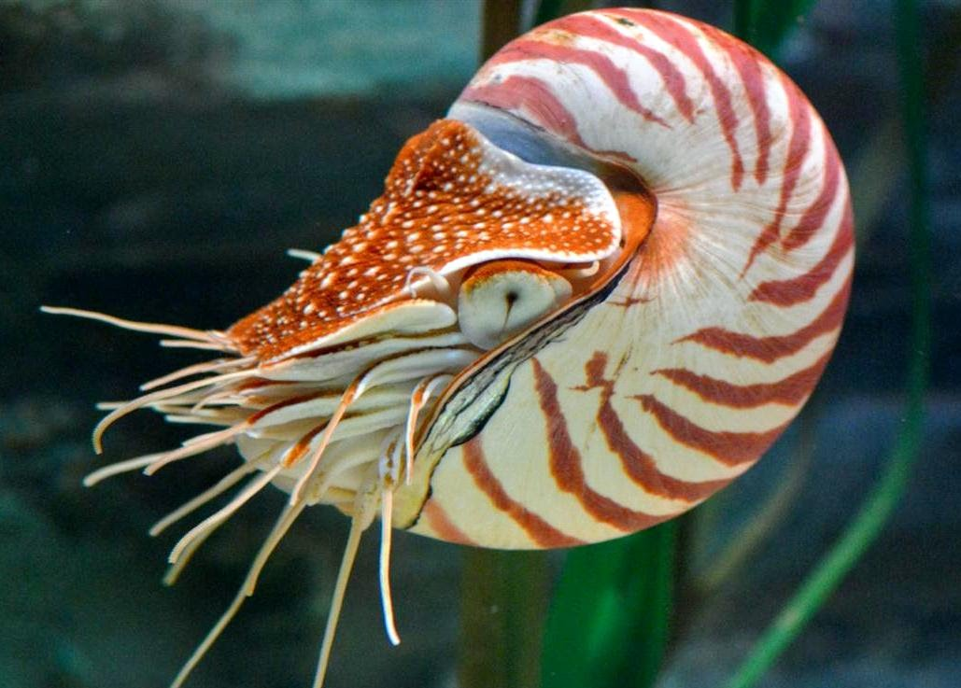
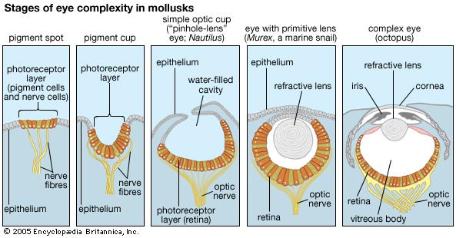
nautilus pompilius

Slide 12
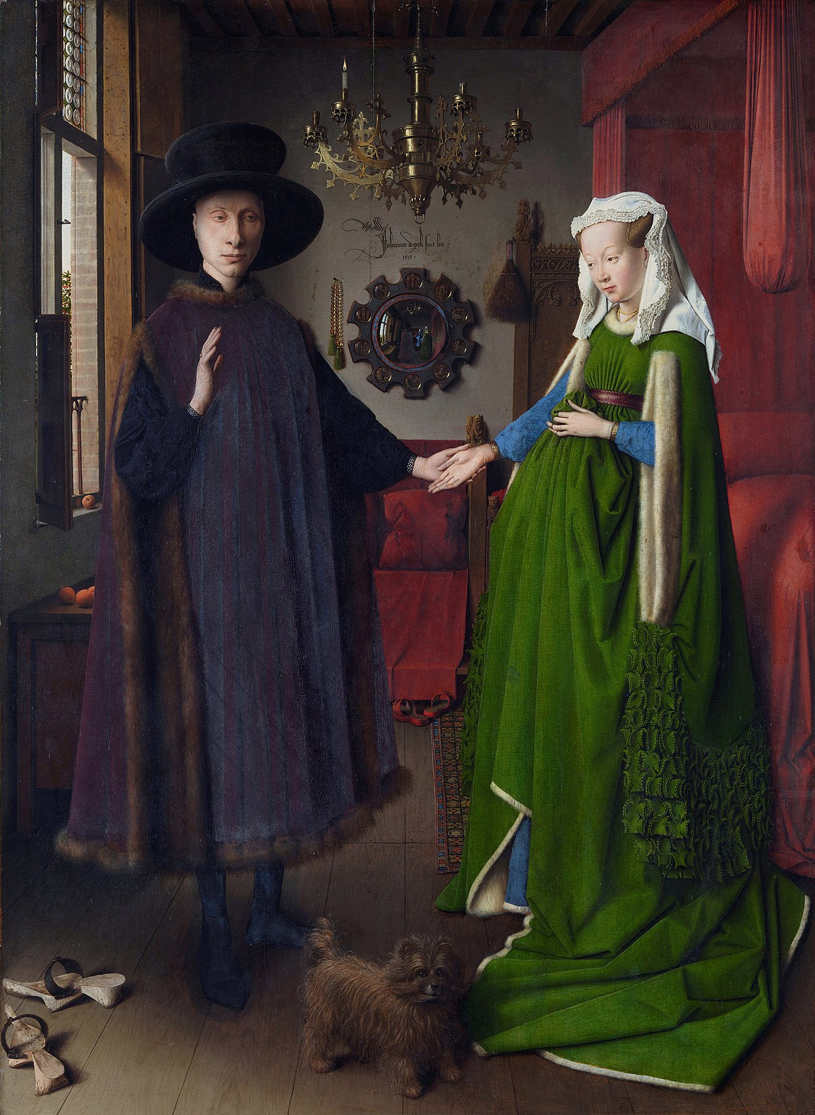
Van eyck, 1434

Slide 13
Van eyck, 1434

Slide 14
Van eyck, 1434

Slide 15
How did he reach such accuracy?

Slide 16
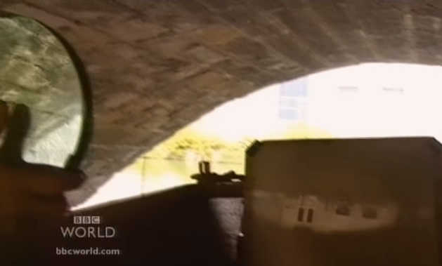
Using a mirror
BBC David Hockneys Secret Knowledge

Slide 17
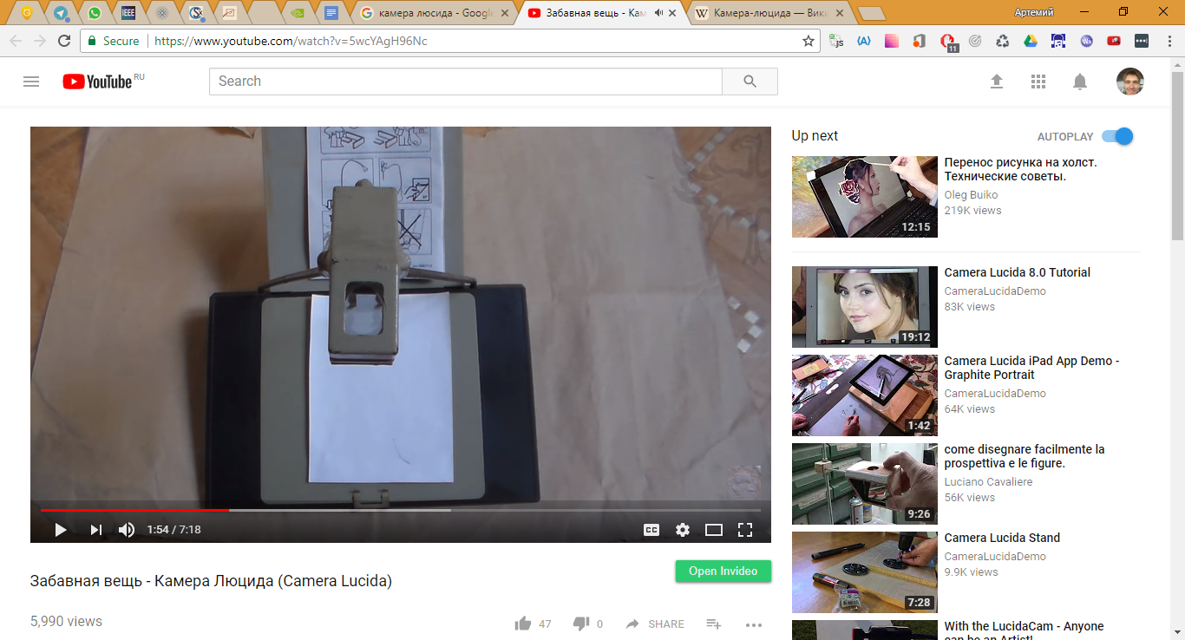
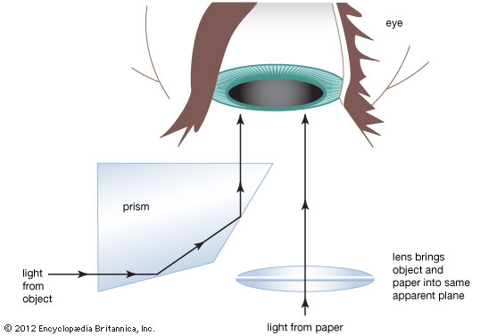
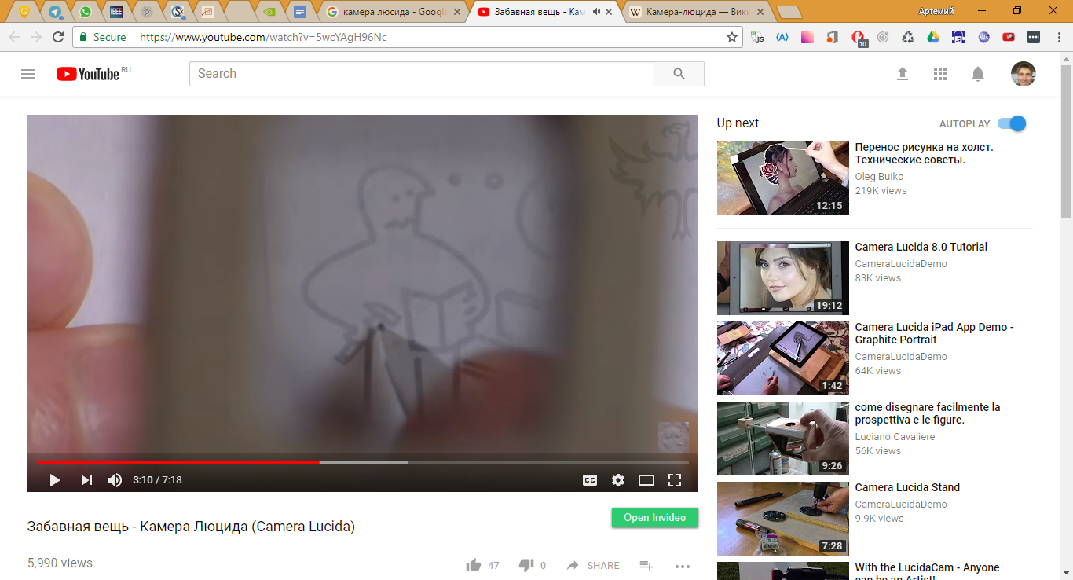
Camera lucida
https://www.youtube.com/watch?v=5wcYAgH96Nc

Slide 18
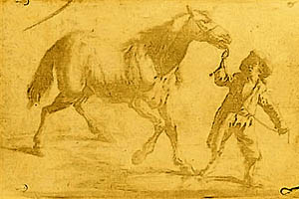
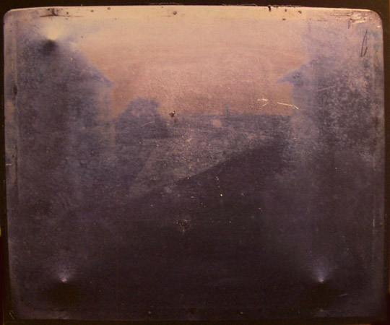
First photo, 1825, 1826

Slide 19
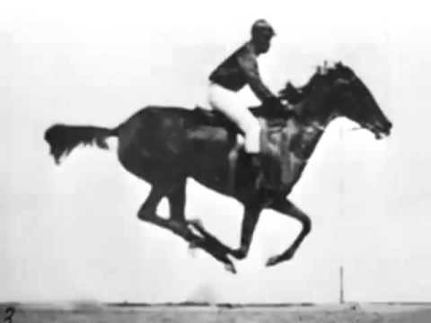
first «video», Edweard Muybridge, 1878
Source

Slide 20
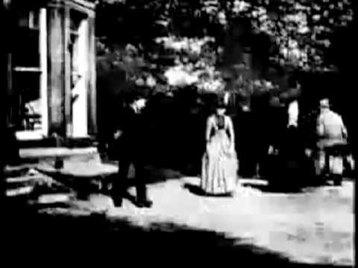
first video, Louis Le Prince, 1888

Slide 21
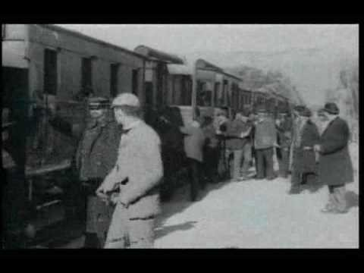
First video, Auguste and Louis Lumière, 1895
Source

Slide 22
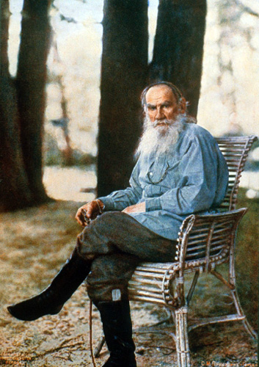
Prokudin-gorskiy, 1915
This is the photo of L.N.Tolstoy made by Prokudin-Gorskiy in 1908.
How was this possible back in 1915?
Source

Slide 23
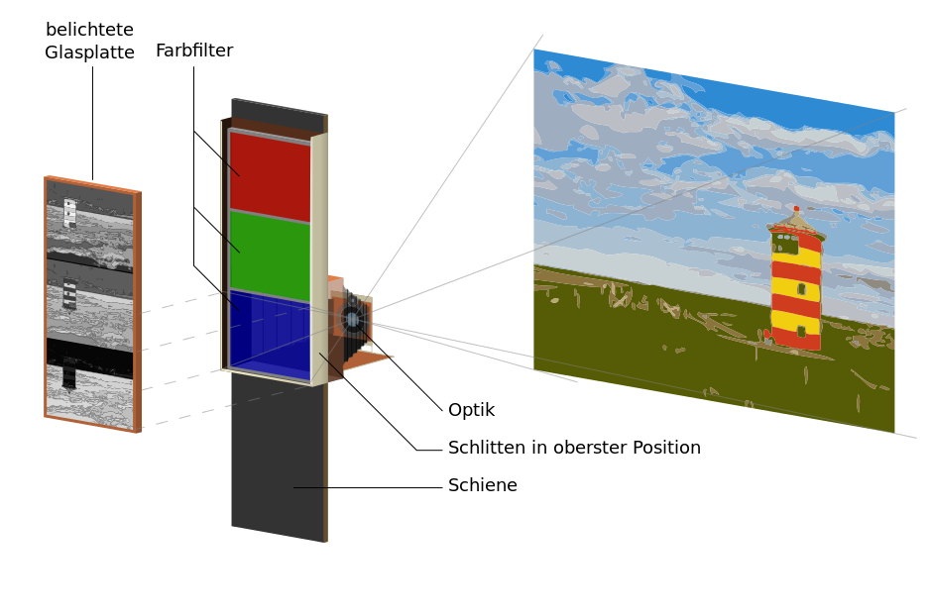
color technology
1850 – Levi Hill
1886, 1908 – Gabriel Lippman
1855 – James Maxwell
1861 – Thomas Satton
Source

Slide 24
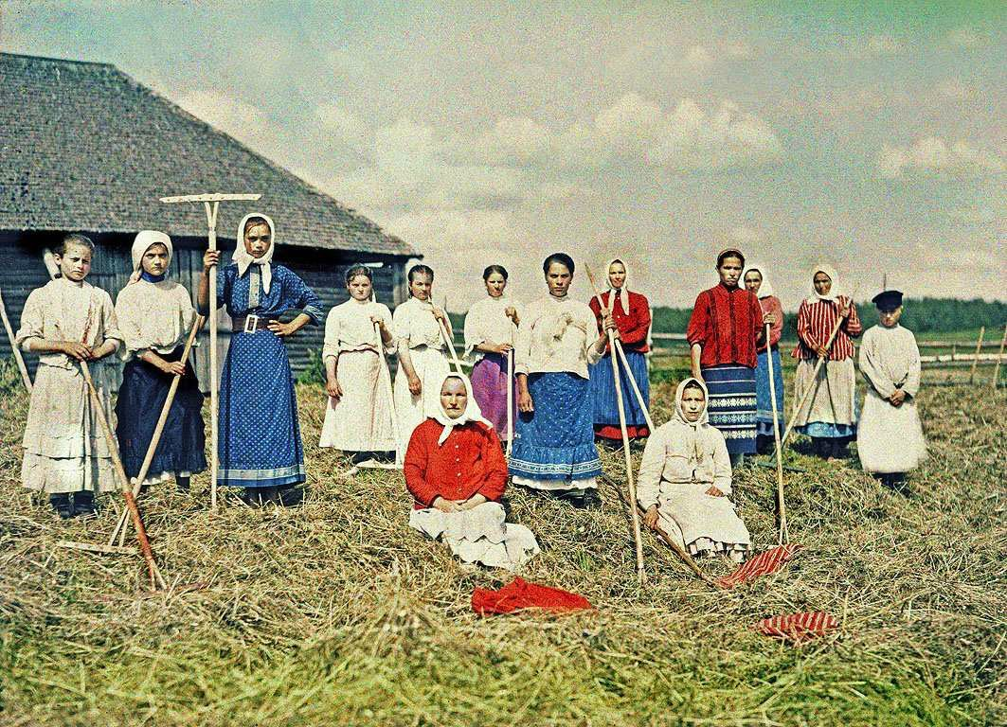
Source

Slide 25
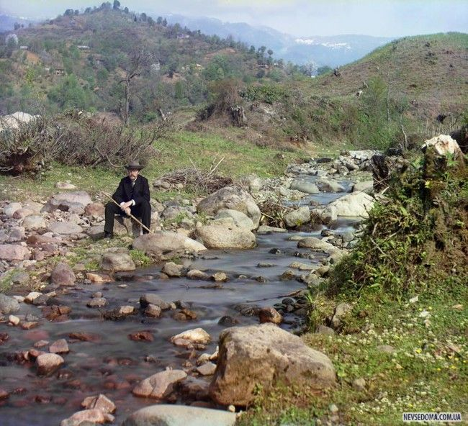
Source

Slide 26

Source

Slide 27
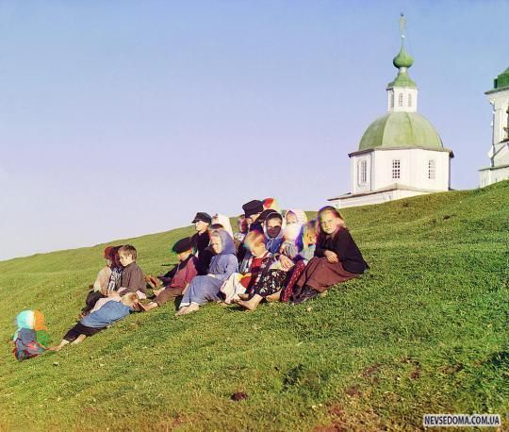
Source

Slide 28
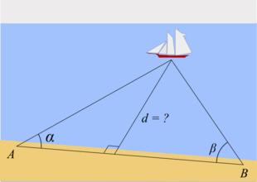
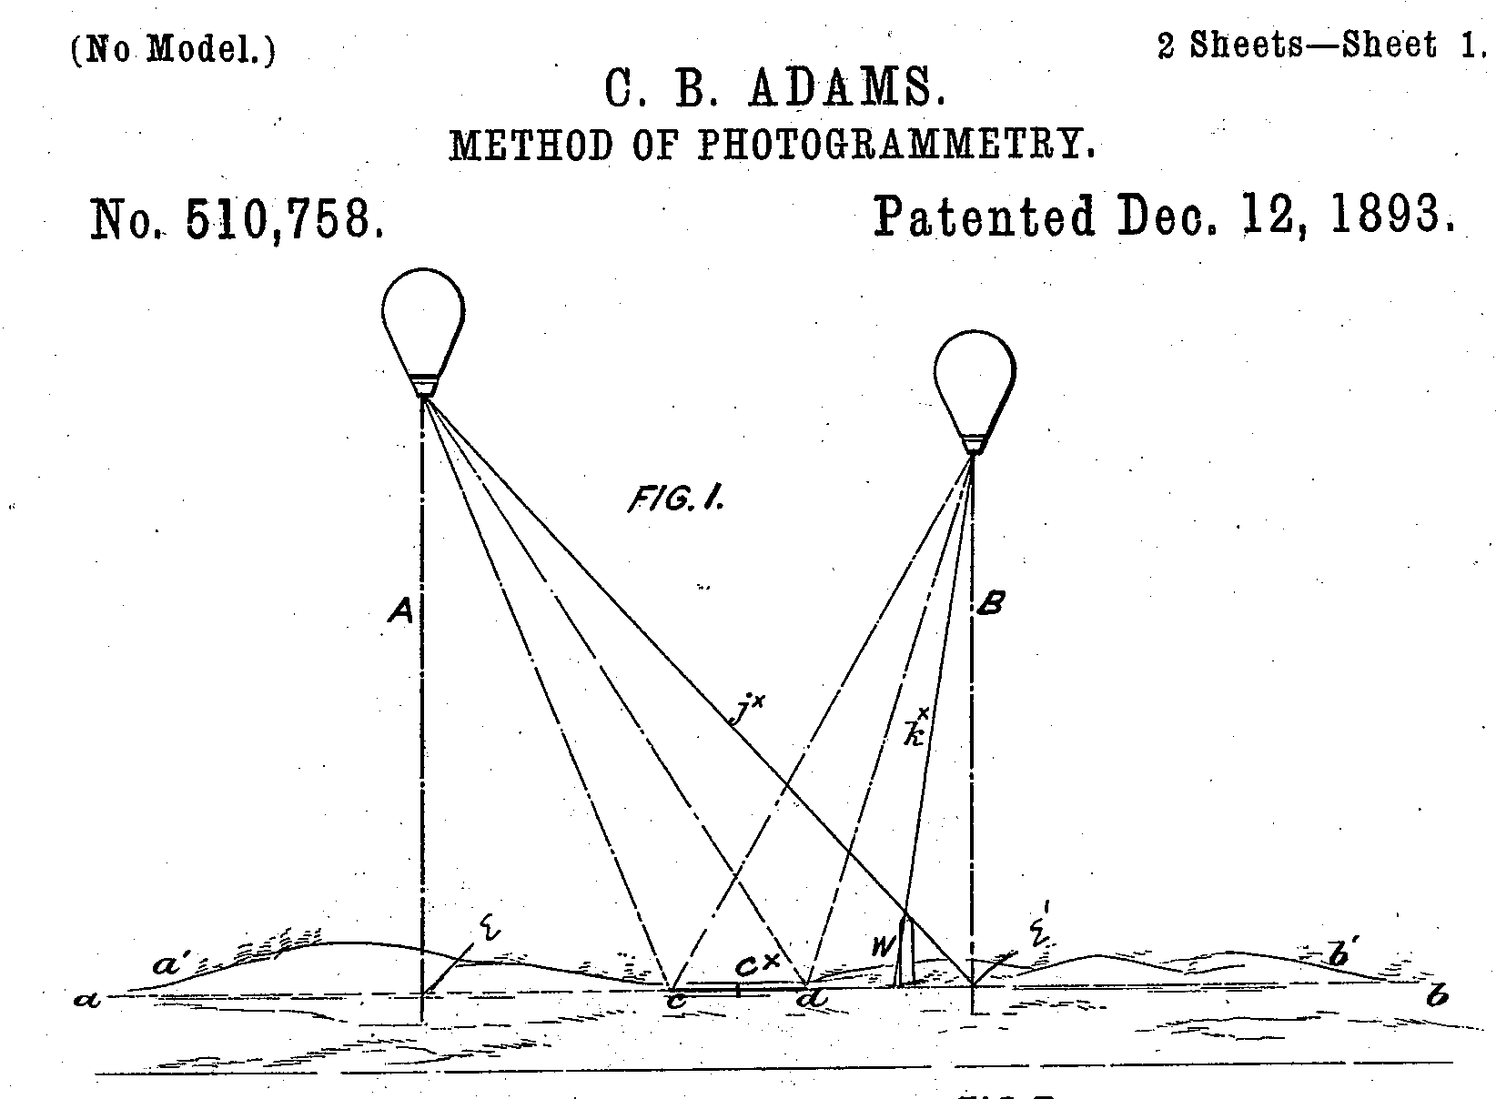
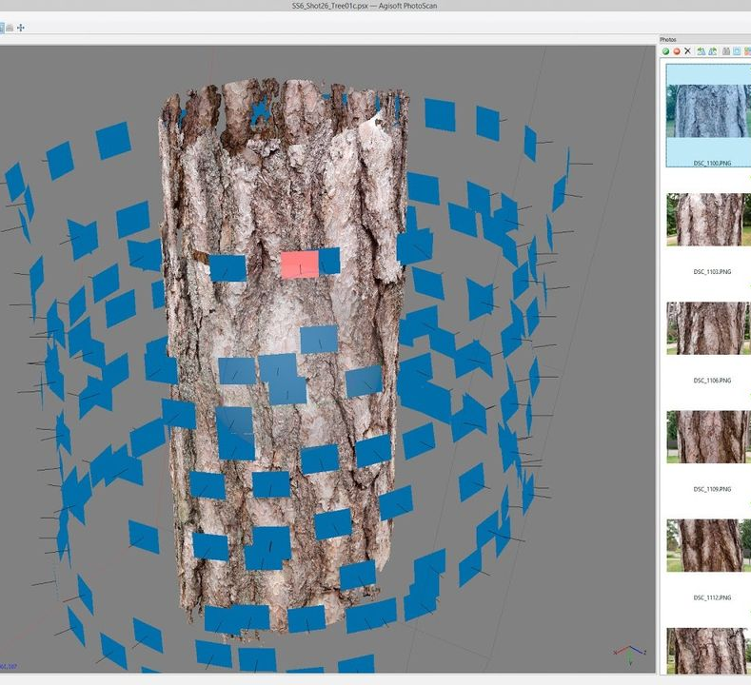
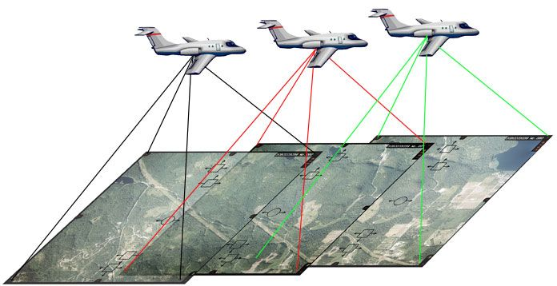
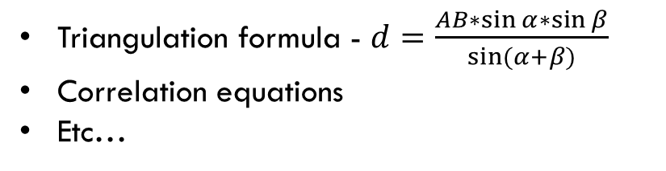
Photogrammetry, ~1850-е
Photogrammetry is the science of making measurements from photographs.
The input to photogrammetry is photographs, and the output is typically a map, a drawing, a measurement, or a 3D model of some real-world object or scene.
Triangulation formula - $d=\frac{AB∗\sin{α}∗\sin{β}}{sin⁡(α+β)}$
Correlation equations
Etc…

Slide 29
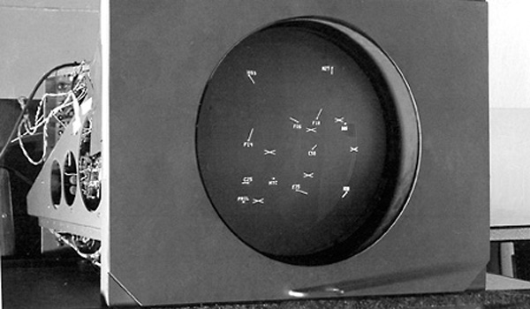
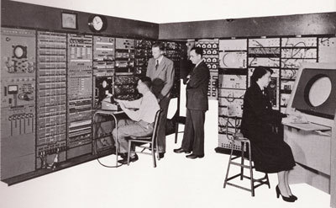
Whirlwind, 1951
Source

Slide 30
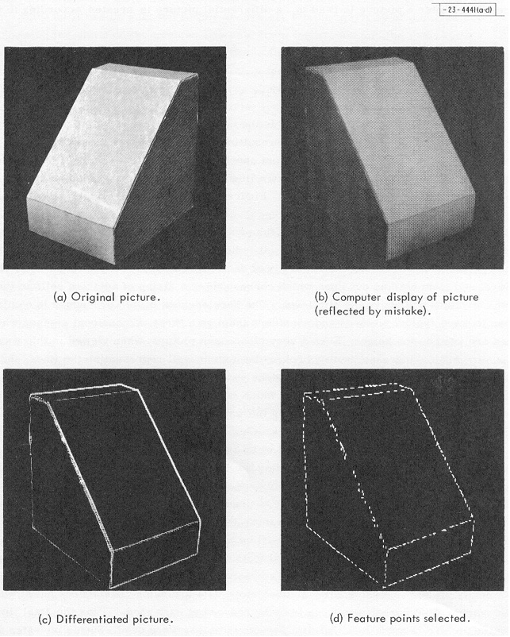
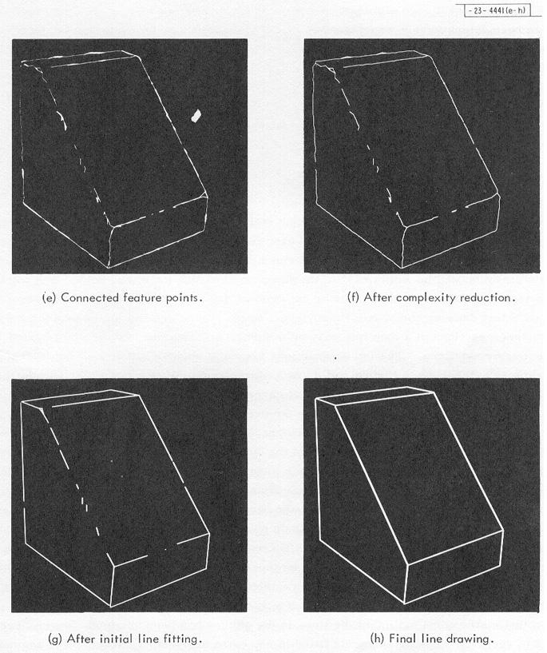
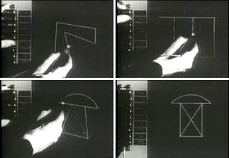
3D solids, 1963
Sketchpad, 1963
Source

Slide 31
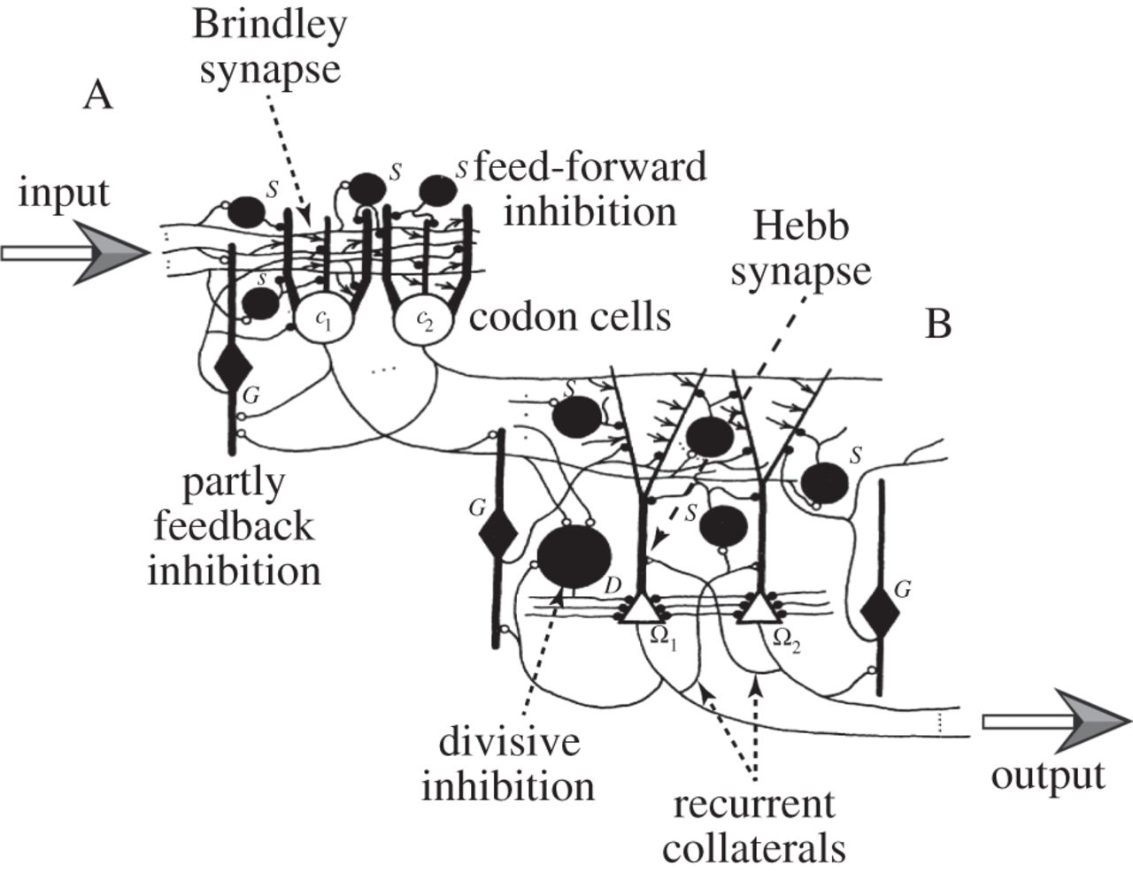
David marr, 1971
A primal sketch of the scene – fundamental shapes recognition – angles, lines, etc
a 2.5D sketch of the scene, texture recognition
a 3D model, scene visualization without gaps
Source, Source

Slide 32
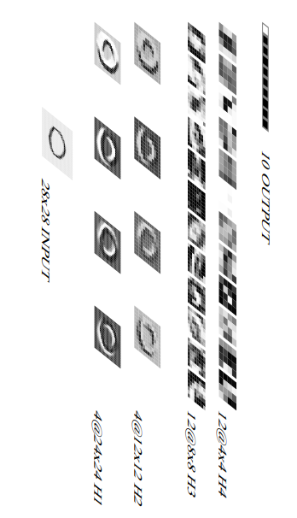
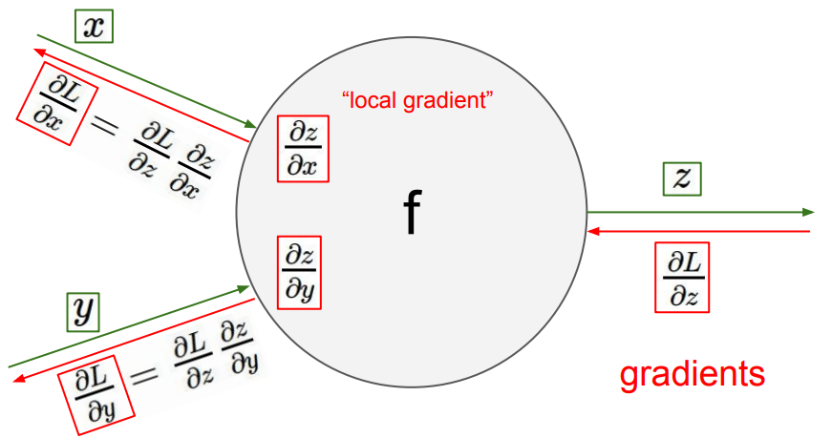

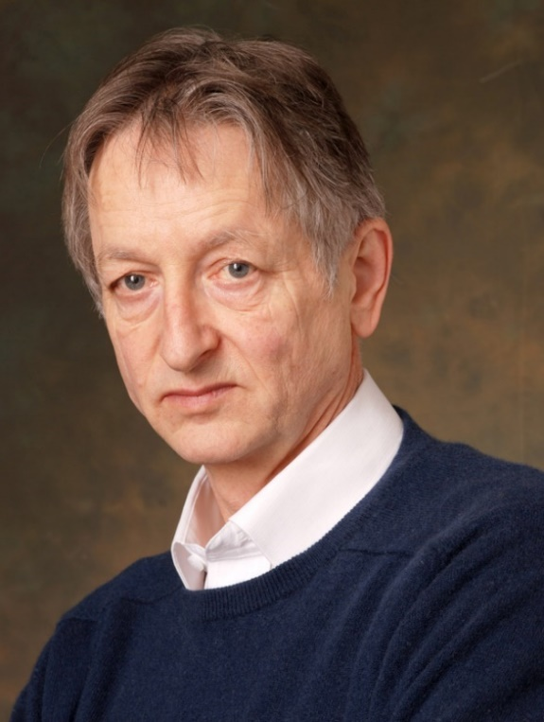
Yann lecunn, 1989
Yann LeCunn
Jeffrey Hinton

Slide 33
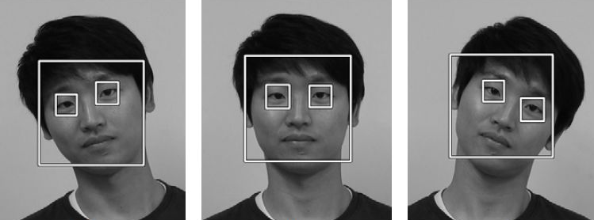

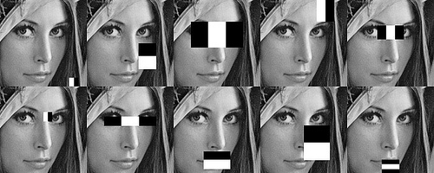
Viola-jones face detector, 2001
Boosting algorithm that utilizes Haar features
Alex Net, 2012

Slide 34
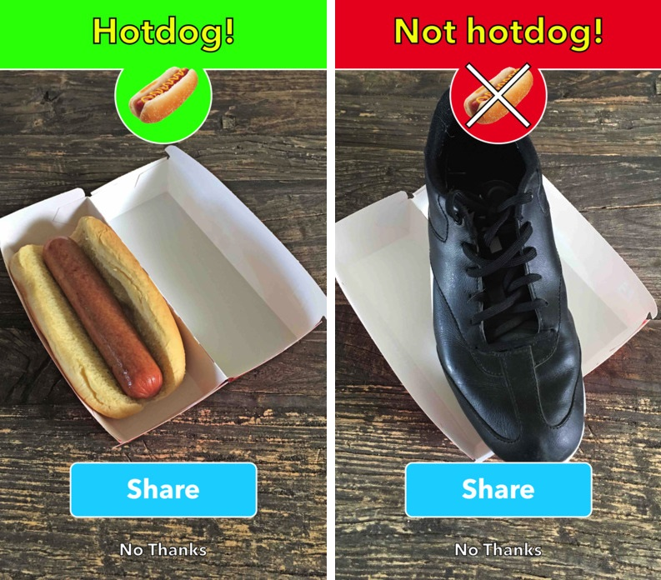
Some applications
“Silicon Valley” series

Slide 35

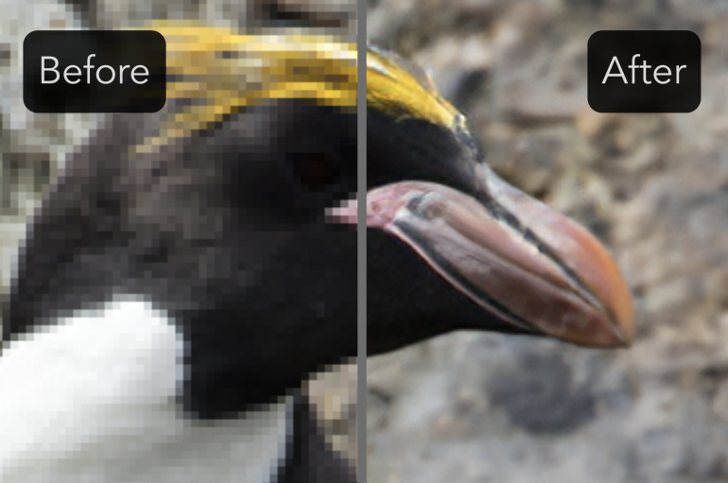
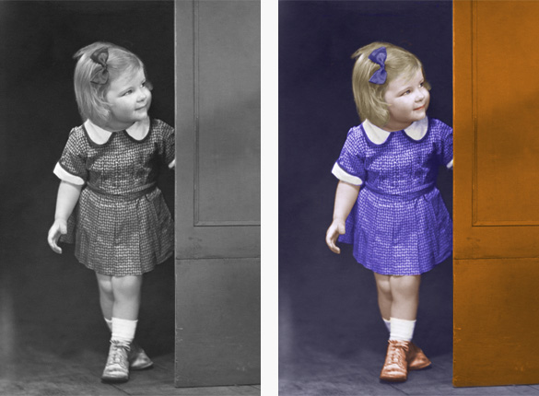
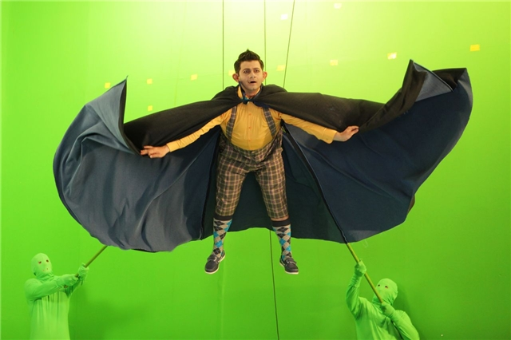
contrast, illumination
Quality enhancement
Eliminating JPEG artifacts
colorization
Creating effects

Slide 36
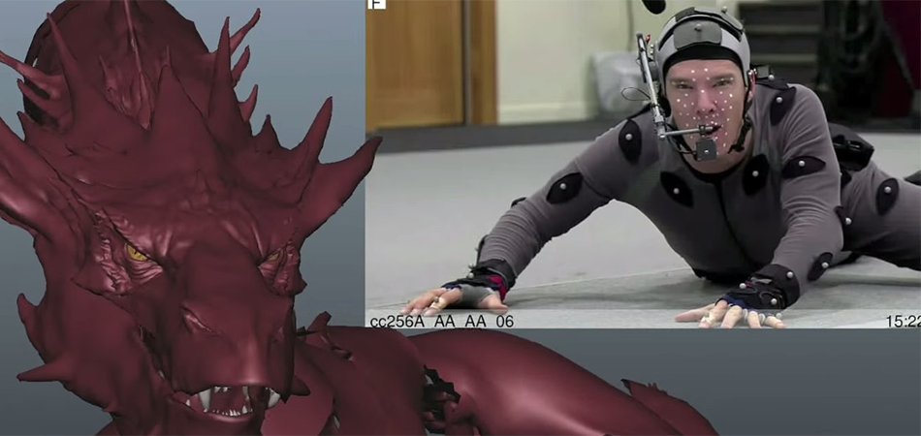
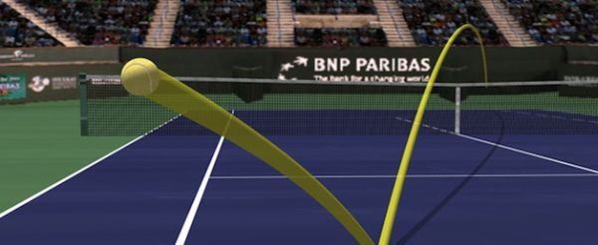
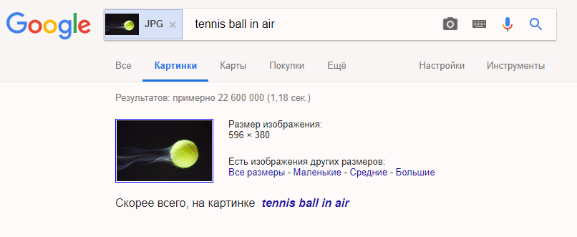
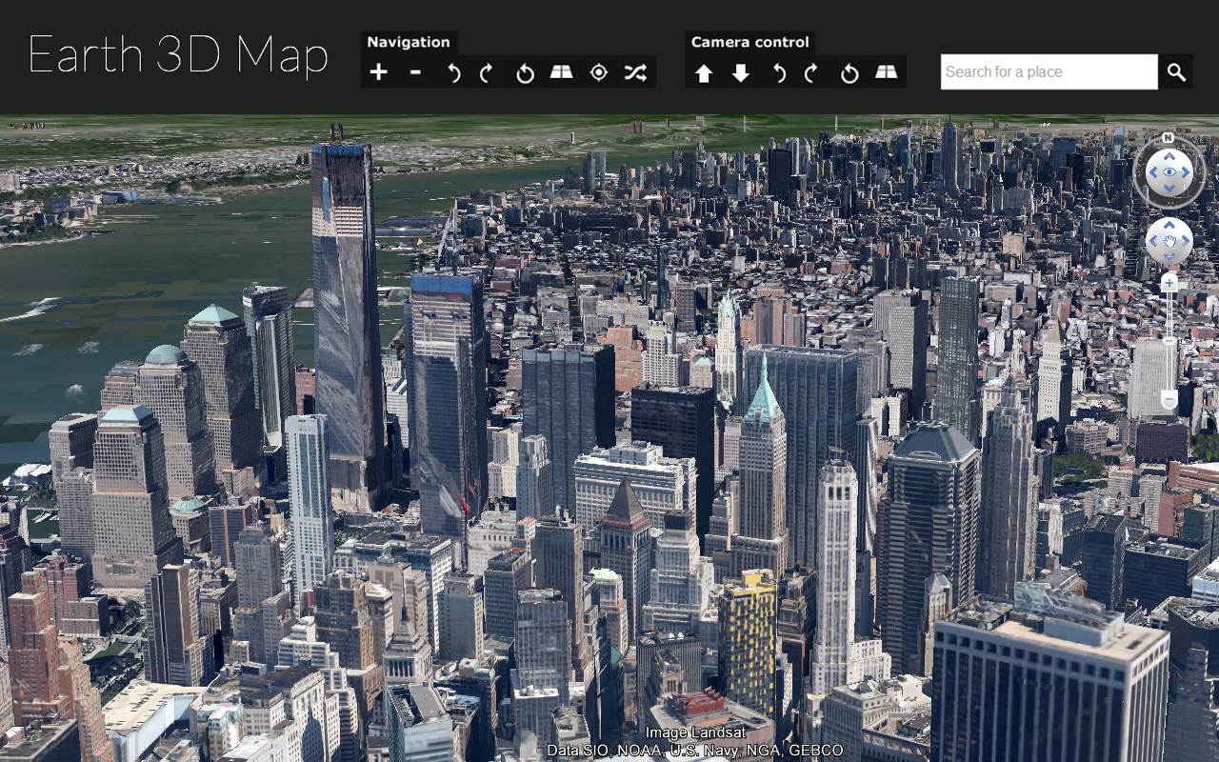
creating 3d models
Sports
The Hobbit: The Desolation of Smaug
Tracing ball trajectory
Search images
MAPS

Slide 37
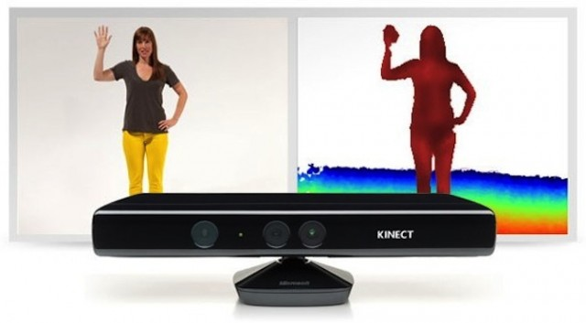
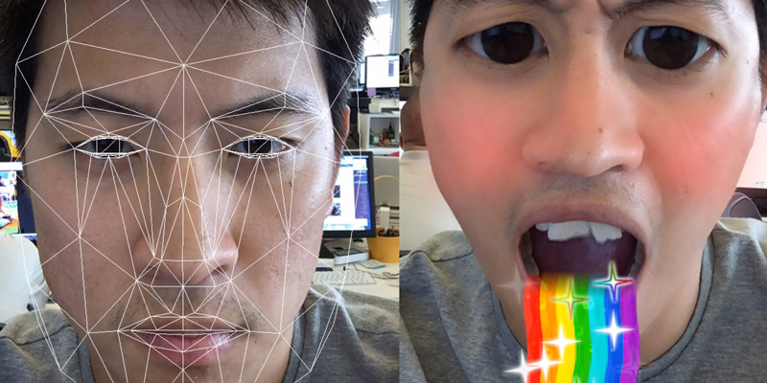
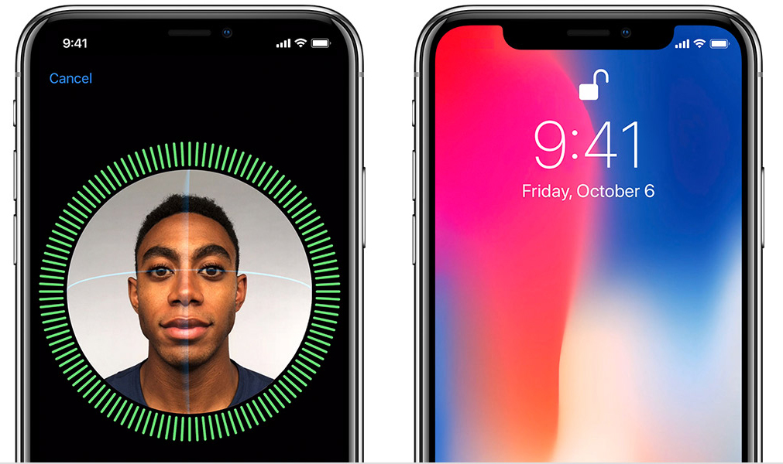


KINECT
Microsoft Kinect, 2009
Snapchat, 2011
Apple Face ID, 2017
Pokemon go, 2016

Slide 38




Self driving cars
Robots
Boston Dynamics, 2018
TV special effects
Deepfake
Corridor Digital

Slide 39

Why doing cv is hard?
Angle of rotation
Scale
Illumination
Angle of photos
3D -> 2D creates ambiguity
…
More examples

Slide 40

Problems visualized
Angle

Slide 41

Problems visualized
Color

Slide 42

Problems visualized
Diversity

Slide 43

Problems visualized
Perspective

Slide 44

Problems visualized
Illumination

Slide 45

Problems visualized

Slide 46

Problems visualized
Aberrations

Slide 47

Human perception
What is on the photo?

Slide 48

Human perception
What is on the image?

Slide 49

Off top
This picture is from Playboy as of 1972
In 1973 Alexander Savchuk used it in his CV work
Lena Söderberg is on the photo
This picture has the big dynamic range – dark and bright pixels

Slide 50

Human perception
What is the color of objects on the image?

Slide 51


Basics
Light is a wave
We can see a very tiny range
What we see is reflections of the light

Slide 52


imperfection of the eye

Slide 53

human vs octopus

Slide 54

Ear vs eye

Slide 55



image
An image is an artifact that depicts visual perception, for example, a photo or a two-dimensional picture, that has a similar appearance to some subject—usually a physical object or a person, thus providing a depiction of it

Slide 56







How to get an image
Filter
Light sensitive element
Non-linear transformation

Slide 57


Signal digitizing
Photosensitive elements
Spatial location is not ideal
They can break
Signal transfer is imperfect
Digitizing of space and brightness

Slide 58


Image is a matrix

Slide 59






Color channels
Mix of 3 with 33% of brightness
Result is different as Windows OS has its own mechanism of dealing with colors based on human's perception

Slide 60



color
Metamers
Day light
Night
Relative visibility
Metamerism – different spectral characteristics can have same impact on the perception of the color
Wavelength, nm
Function of human's sensitivity of brightness in day/night
Color – subjective characteristic of the electro-magnetic optical range

Slide 61

spectrum
Different objects have different spectrum
Texture, material, etc. affect the spectrum

Slide 62


Grassman’s laws
Trichromatic theory
Choose 3 base colors (wavelengths)
Find codes for other colors using base experimentally
There are 4 laws (see Wikipedia), but they basically express the idea that empirical perception of color is linear.

Slide 63


LMS model
Calculate the codes using this function and known illumination on an object
There are LMS variations that are not possible in nature
You cannot build a display using LMS model
Take the function of spectral response of eye cones normalized by max value

Slide 64

Cie rgb, 1931
R = 645.2 nm
G = 525.3 nm
B = 444.4 nm
Can we code every color using that model?

Slide 65

Color matching function

Slide 66

Color gamut
Color gamut illustrates the visible spectrum and spectrum that can be coded in different color models

Slide 67

HSV model
RGB model does not have brightness
So when the color TV appeared someone solved that problem by introducing HSV model
Hue, Saturation, Brightness

Slide 68

Cmyk subtractive model
Useful in print

Slide 69
Some videos about eyes / photo / …
How Was Video Invented?
Resolution of the eye
5 Things to Know About Eyes | Explorer
Do you see red the way that I see it?
What Color Is A Mirror?
How Many FPS Can Your Eye See?

